Slide 1


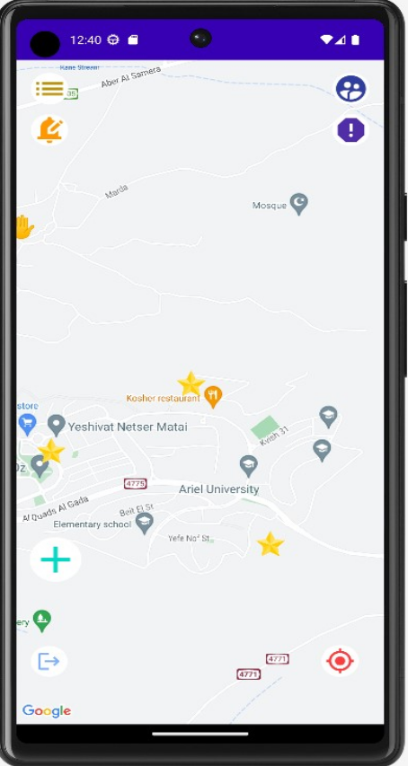
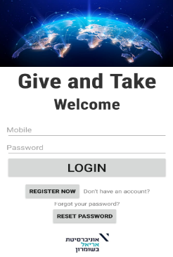



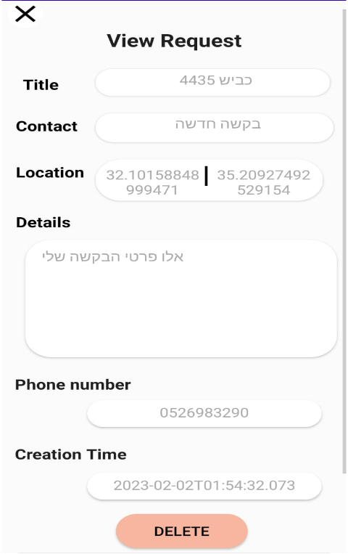
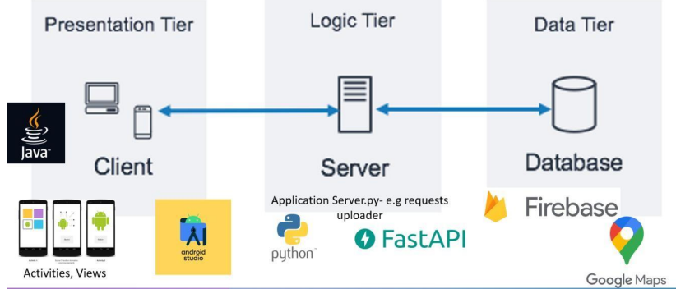
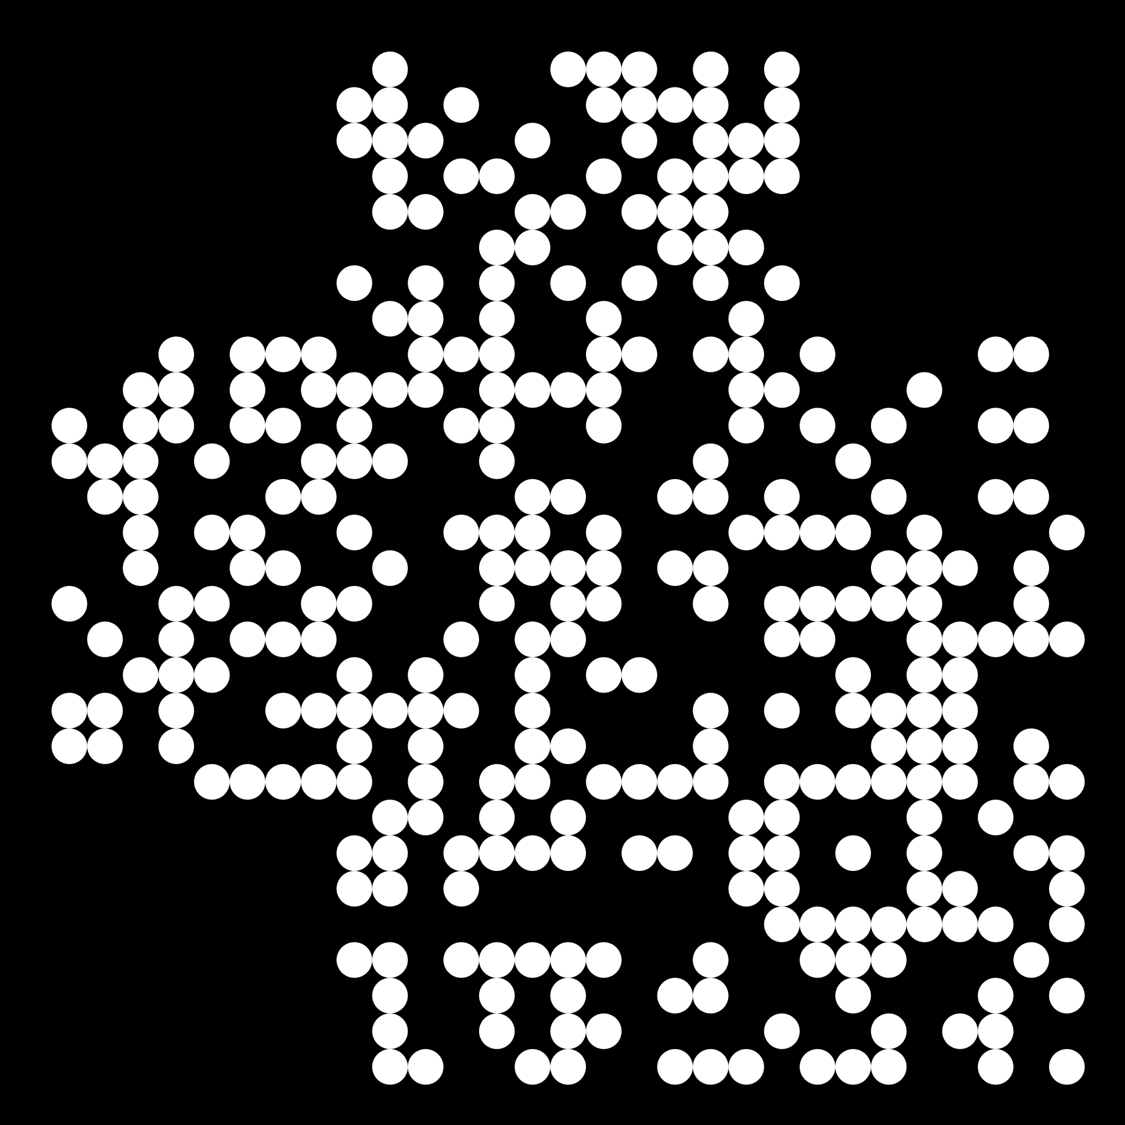
GIVE AND TAKE INFORMATION SYSTEM POSTER Group ID: 40
Developer: Shavit Luzon | Instructor: Saeed Asaly | Computer Science and Mathematics Final Project
INTRODUCTION
IMAGES
METHODOLOGY
FUNCTIONALITIES
THIS PLATORM PROVIDES…
IN-APP
Combining the power of a map service using Google Maps, with data storing using Firebase Real Time database, to create a system dedicated for Ariel University’s students and staff
Many times requests and events depend on location, for example, seeking a partner for solving a math task, to study to sociology test or to seek volunteers for helping elderly near the campus. There is a need to conveniently filter opportunities by location.
users to create requests and delete their own
user registration and login with stored details
a reliable, live and responsive map shared by users
communication between the users of the application
requests display by dedicated icons on map
“Locate me” option on map
notification of a new request or event according to the user's preferences: on a chosen radius of live/ pre-determined location ADMIN PRIVILLIAGES:
block users and delete requests
add an event with a special icon
watch users’ list & users’ requests’ list SECURITY:
two-factor authentication
Requires university email verification to register users
Requires phone number verification by SMS code
Displays a notification on the phone about a new request or event according to the user's preferences.
METHODS
Java Android components
HTML, CSS for Client UI
Cloud Database
Python server API
Map service integration
GPS sensor activation
PROJECT GOAL
To supply a sharing social platform for Ariel University students/staff to connect, to “give and take” help and post events, easily based on location.
MODULATION
Using MVC Pattern for Android developing and 3-Tier Architecture:
CONSIDERATIONS THE SYSTEM NEEDS…
requests to be browsed and stored real time
location visualized
to be kept an exclusive, safe place
Users allowed to communicate
Admin users managing the app
CONTACT INFO
luzonshavit00@gmail.com
+972 52 69 83 290
GitHub repo QR:

